Slide 1
Module 6 DependCare Program

Slide 2
Module Profile
Overview of helpful tools created by Kimberly-Clark
To help manage incontinence with greater confidence, efficiency & effectiveness
You’ll see:
An overview of the Care program
Explanation of tools & how to use them
How special forms make it easier to manage incontinence

Slide 3
Program Components
Education
Depend e-learning or at dependcare.com.au
12 educational modules
Notes:
There are 12 modules:
Introduction to urinary incontinence
Urinary continence assessment
Managing Urinary Incontinence
Managing faecal Incontinence
Effective Product Use
DependCare Program
Catheterisation
Elderly continence & incontinence effects
Continence aids
ACFI
Infection control
Falls Prevention

Slide 4
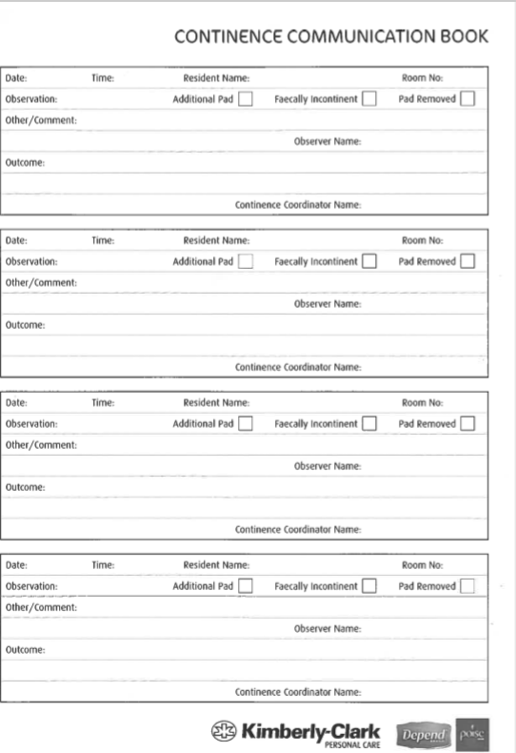
Program Components
Continence Communication Book
Promotes open communication between Carers, Depend Co-ordinators & RNs
Notes:
Since only the Depend Co-ordinator or RN can change the type or number of pads a resident is using, the ‘Continence communication book’ allows Carers to record issues or incidents involving a resident
The Co-ordinator or RN can then respond, even if they’re not working the same shifts as the person who recorded the observation

Slide 5
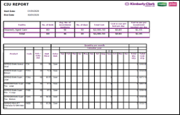
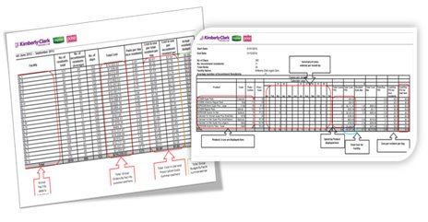
Program Components
Depend eCM
Easy-to-use software program:
Helps manage incontinence programs for low & high care residents
Helps conduct a thorough stocktake
Generates order forms
Creates residents’ Care Plans
Generates cost-in-use statistics & useful reports
Helps manage your continence budget
Notes:
Kimberly-Clark provides an easy to use online management system called Depend eCM… electronic continence management
The system also generates order forms for continence products that can be emailed to your distributor of choice

Slide 6
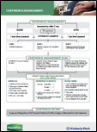
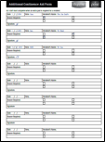
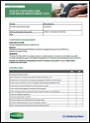
DependCare Tools & Resources
A number of forms are needed to
Comply with accreditation standards, &
Successfully run a continence management program
Continence Management Manual​
Supplied to every facility
Continence Management Flow Chart
Found in the ‘Manage with Confidence’ manual
Audit Tool​
Quality assurance and Continuous Improvement Tool
Additional Pad Sheet​
To track increase in usage for residents
Notes:
Kimberly-Clark has developed easy-to-use forms that aren’t time consuming to complete & that meet accreditation standards
Let’s take a look at some of the forms…

Slide 7
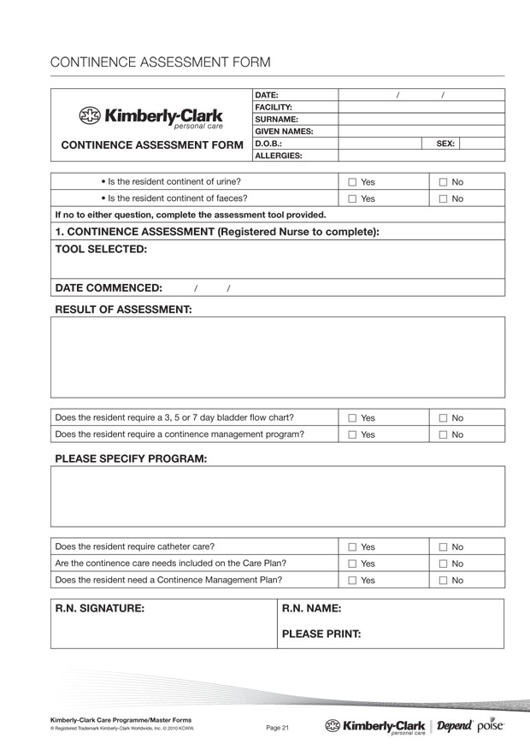
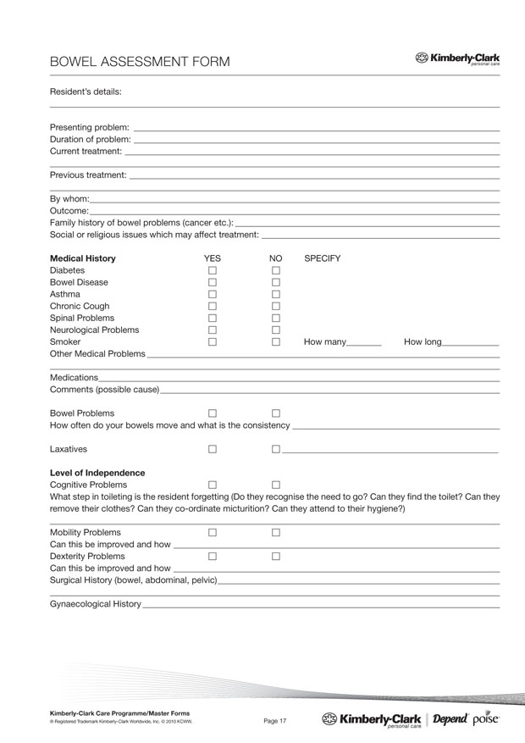
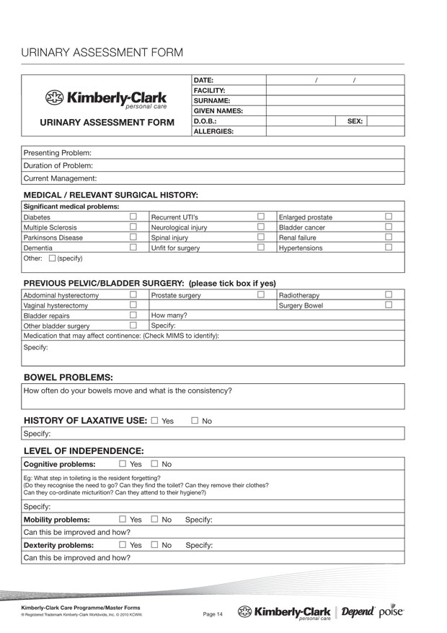
Assessment, Record & Evaluation Forms
Assessment forms
To assess a resident’s level of incontinence
Help determine residents’ product requirements
Continence aid assessment/reassessment form
Used by Depend Co-ordinator or RN to assess residents’ level of incontinence

Slide 8
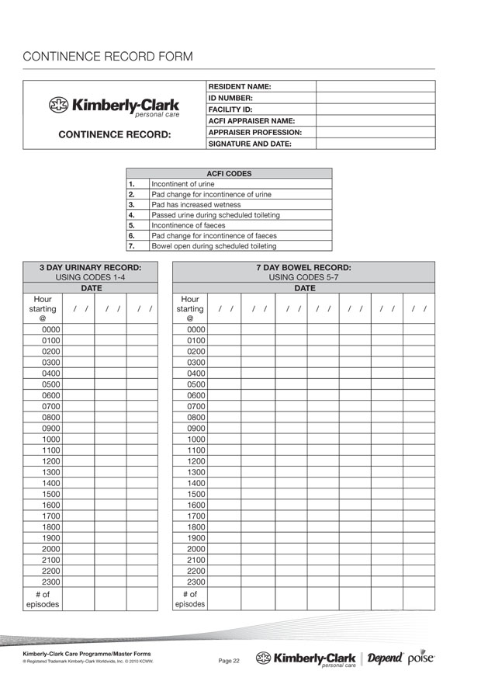
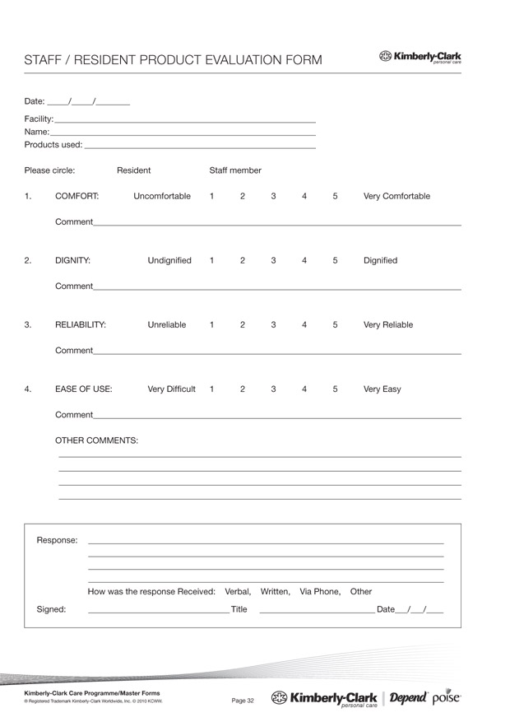
Assessment, Record & Evaluation Forms
Continence record form
To assess, preferably hourly, when resident goes to toilet over 3-day period
Product evaluation form
Notes:
Use a product evaluation form if your facility or Kimberly-Clark Personal Care representative asks for feedback on Kimberly-Clark products

Slide 9
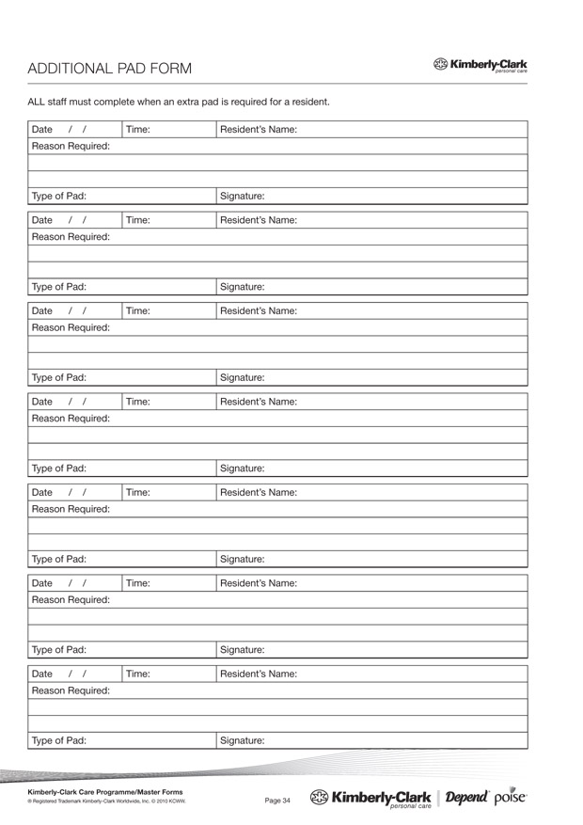
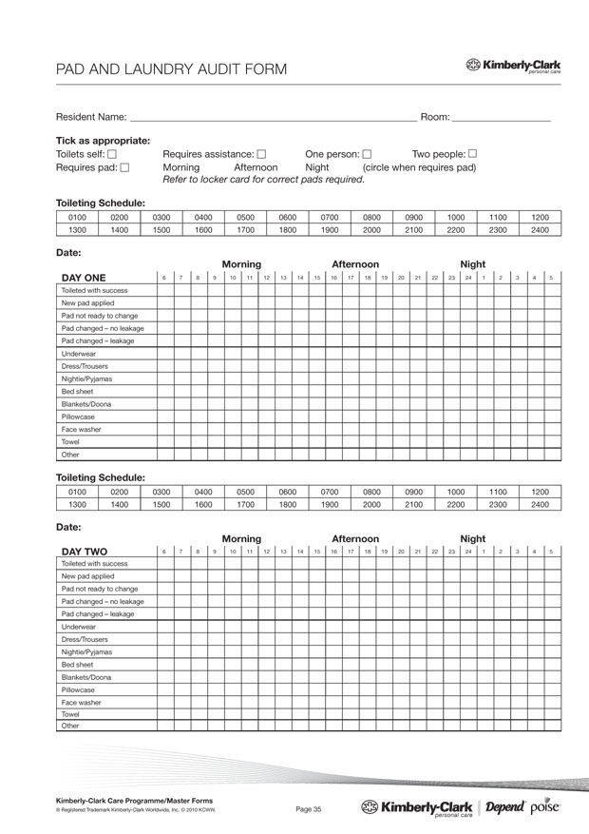
Other Forms
Additional pad form
If an additional product is required outside the normal allocation for a resident
Pad & laundry audit form
1 form per resident to track their wetting behaviour & amount of laundry this generates

Slide 10
Continence Communication Book
Continence Communication Book
Enter date, time, resident’s name & room number
Write your observation & your name
Depend Co-Ordinator to review regularly to post outcomes
Notes:
To help your facility improve use of the Care program & maintain high standards, your Kimberly-Clark Personal Care representative may do a spot check and audit of your facility to provide constructive feedback.

Slide 11
This certifies that
Name:
has attended the continence management session
Module 6: DependCare Program
Date of Completion_______________________________

